Slide 1
INSTALLATION OF FLEX,BISON,DEV C++

Slide 2
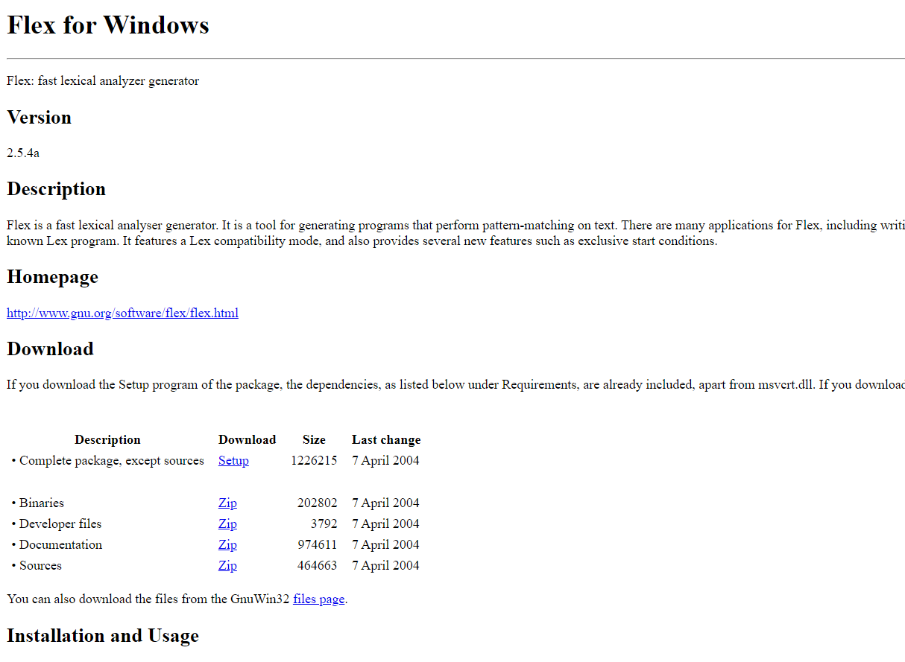
Download Flex at https://gnuwin32.sourceforge.net/packages/flex.htm
Click on Setup

Slide 3
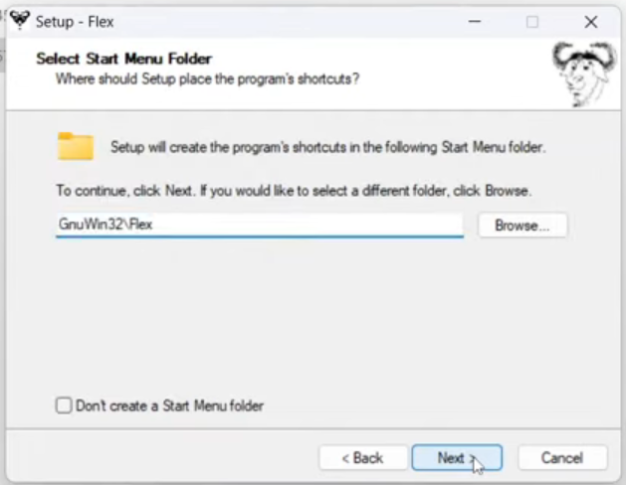
Install in C:\GnuWin32

Slide 4
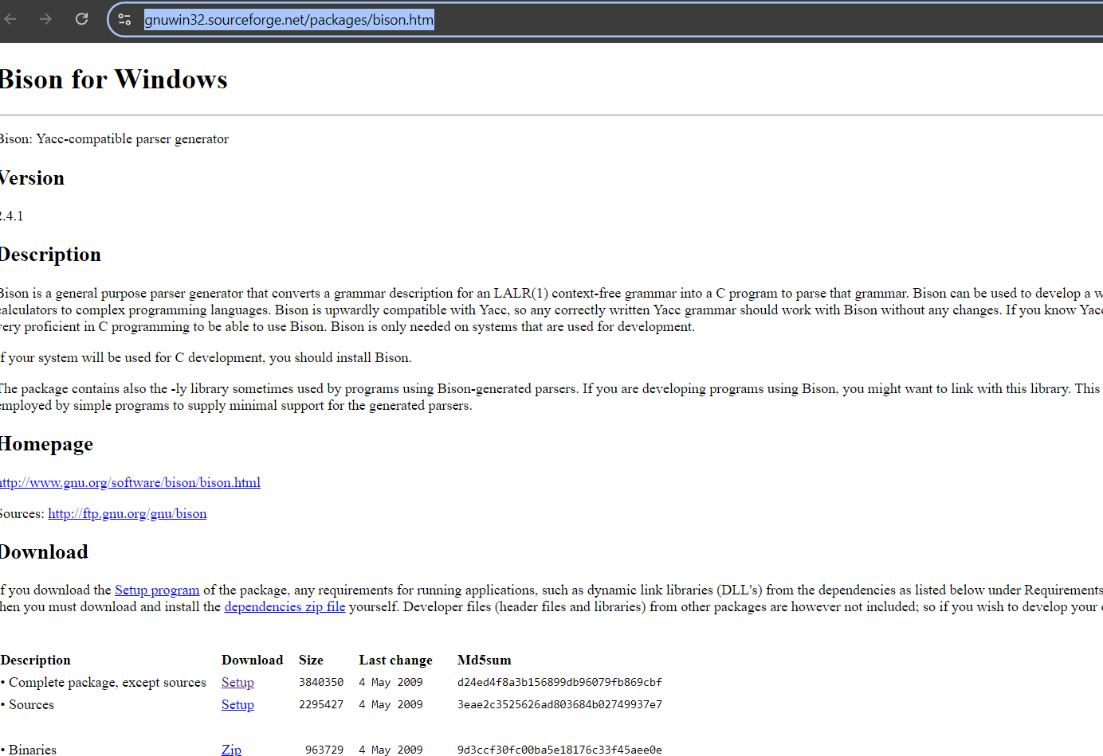
Download Bison https://gnuwin32.sourceforge.net/packages/bison.htm

Slide 5
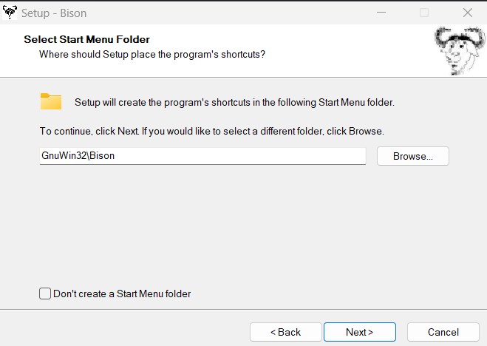
Install in C:\GnuWin32

Slide 6
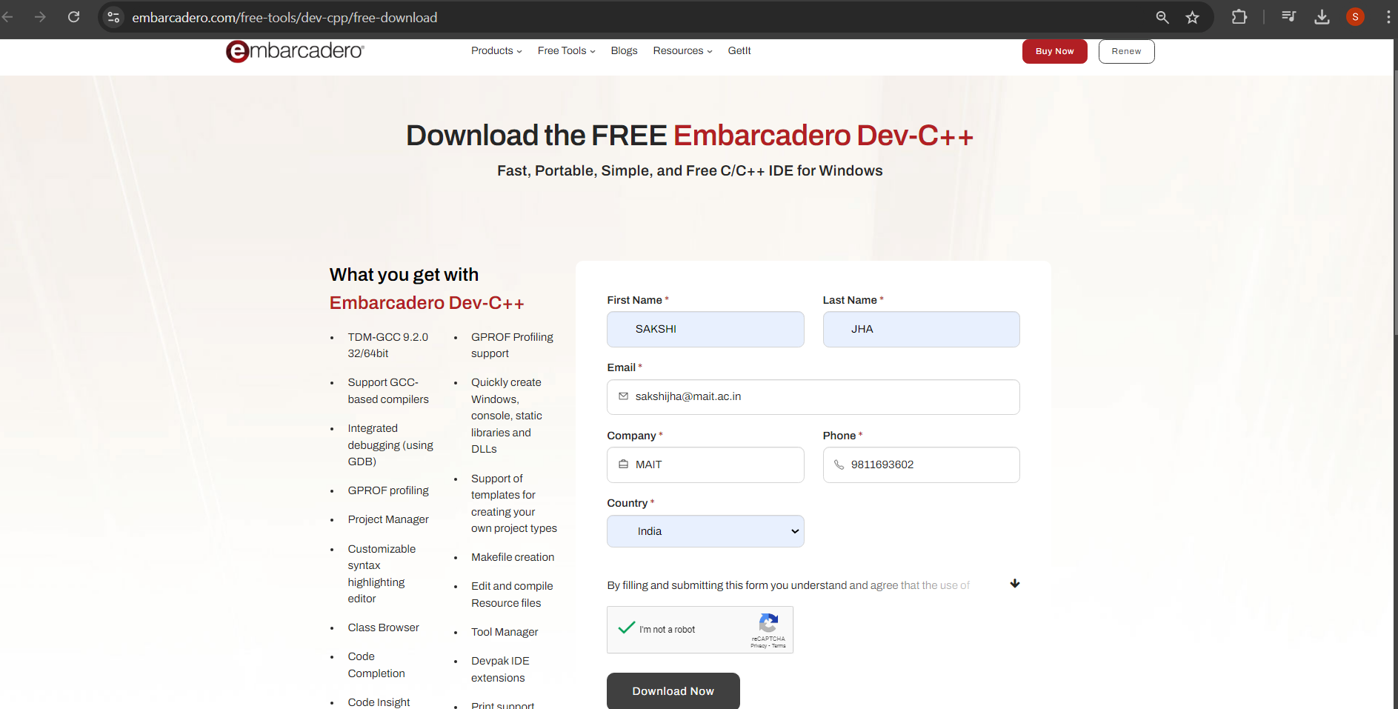
Download Dev-C++ https://www.embarcadero.com/free-tools/dev-cpp/free-download

Slide 7
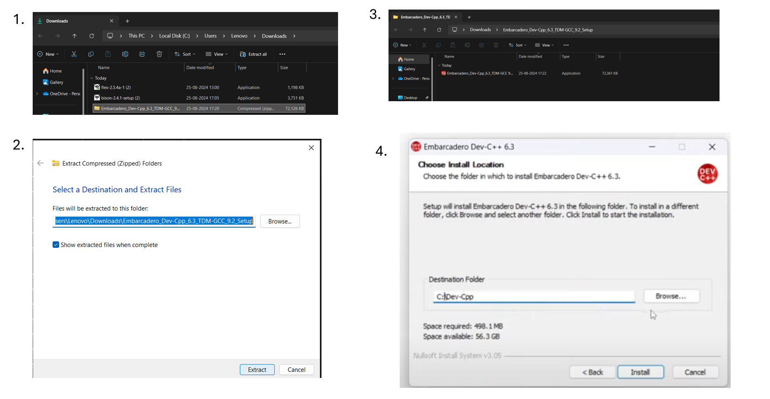
Extract the folder & Install in C:\Dev-Cpp

Slide 8
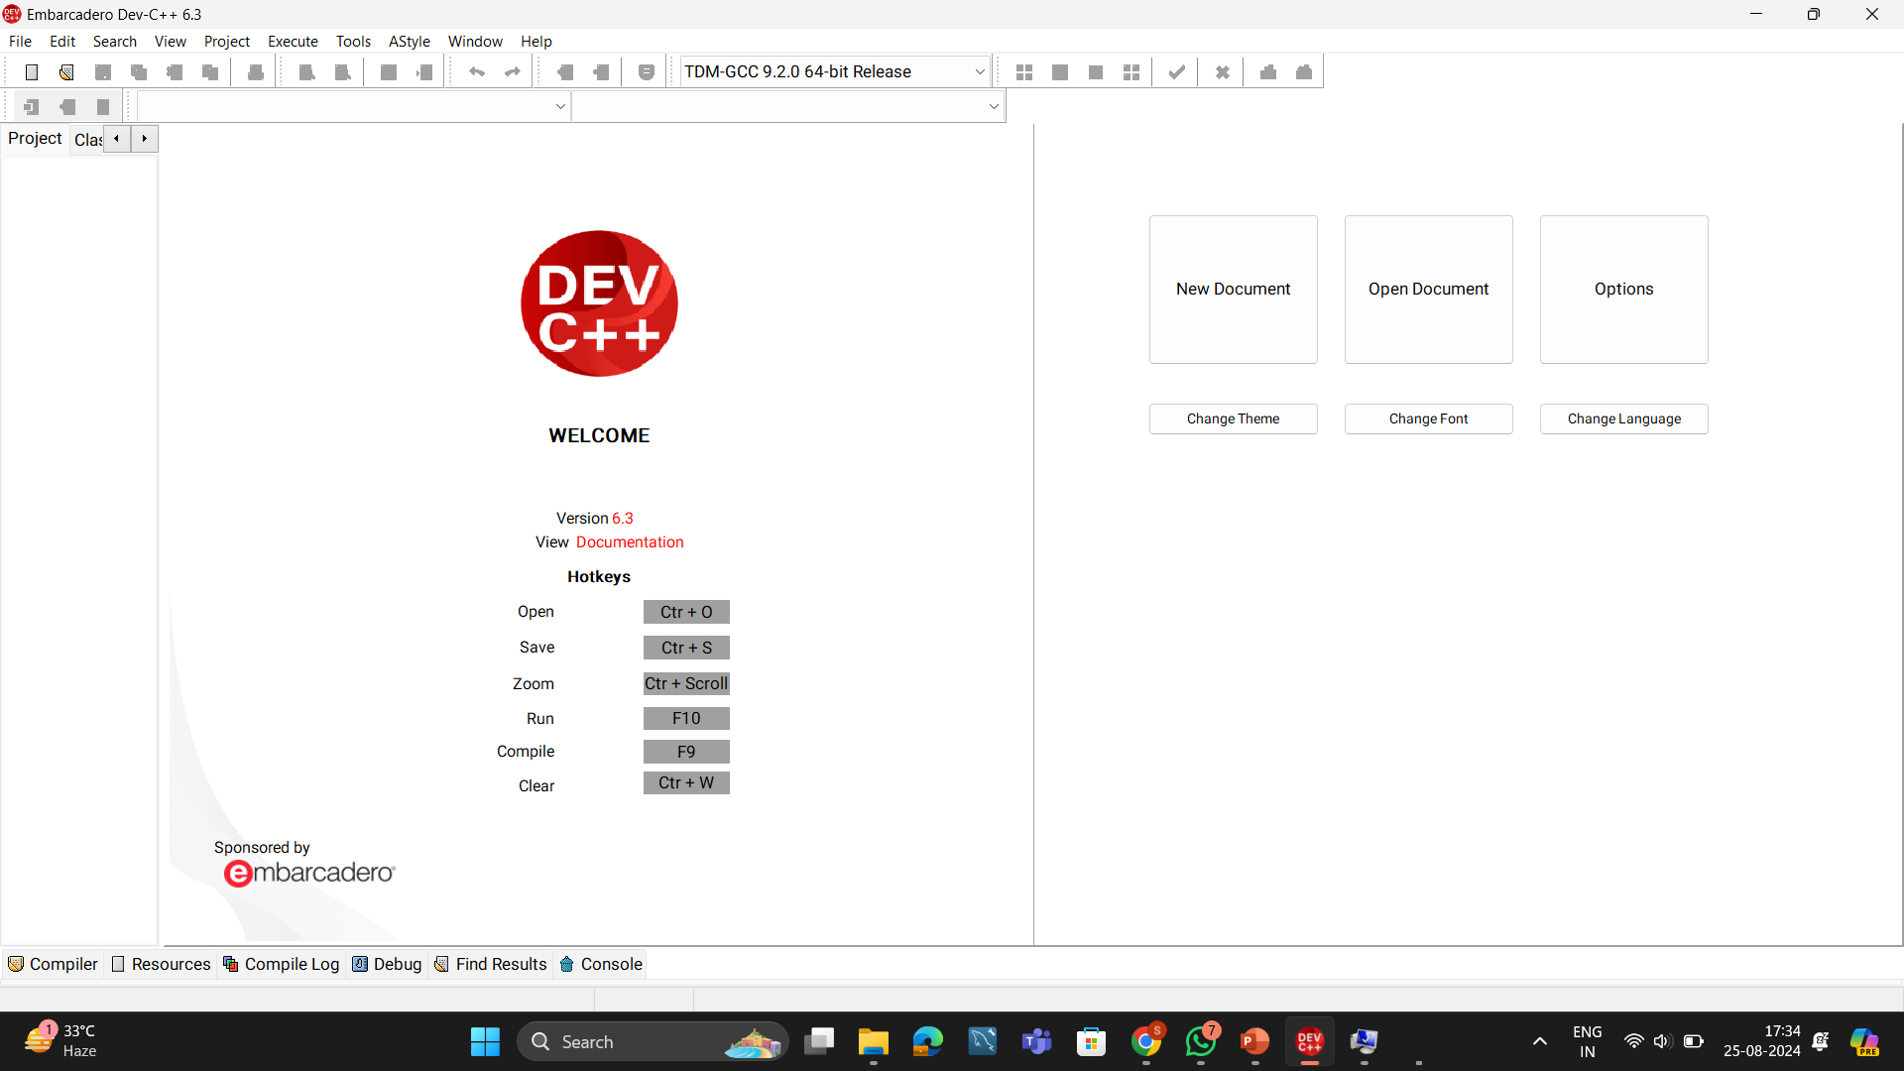
Successful Installation Done

Slide 9
https://sourceforge.net/projects/dev-cpp/files/Binaries/Dev-C%2B%2B%204.9.9.2/devcpp-4.9.9.2_setup.exe/download

Slide 10
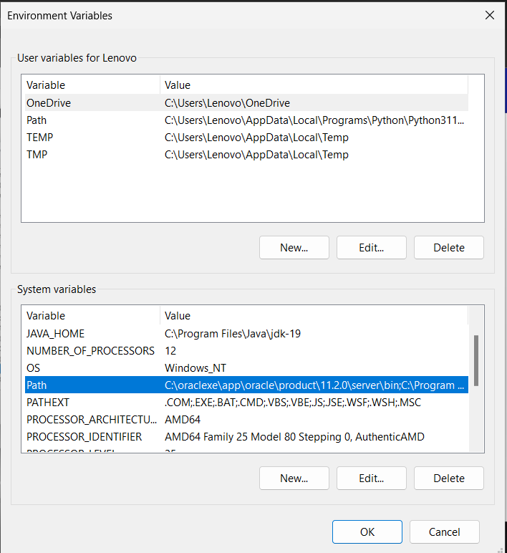
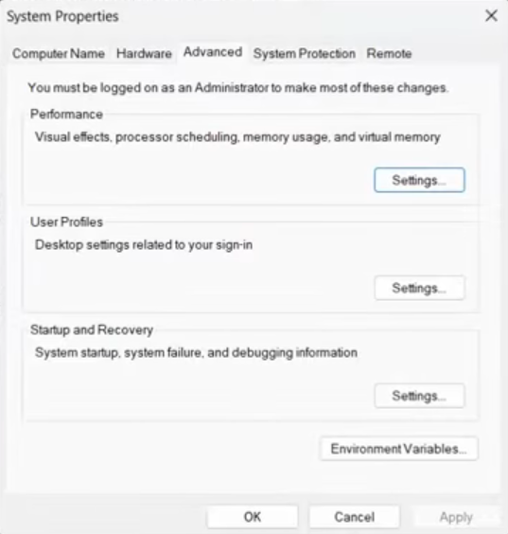
Setting Environmental Variables

Slide 11
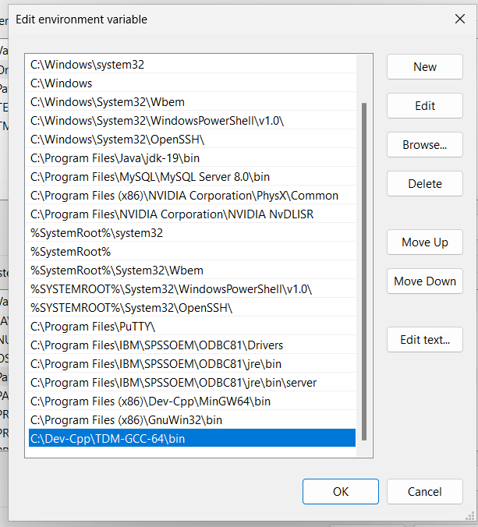
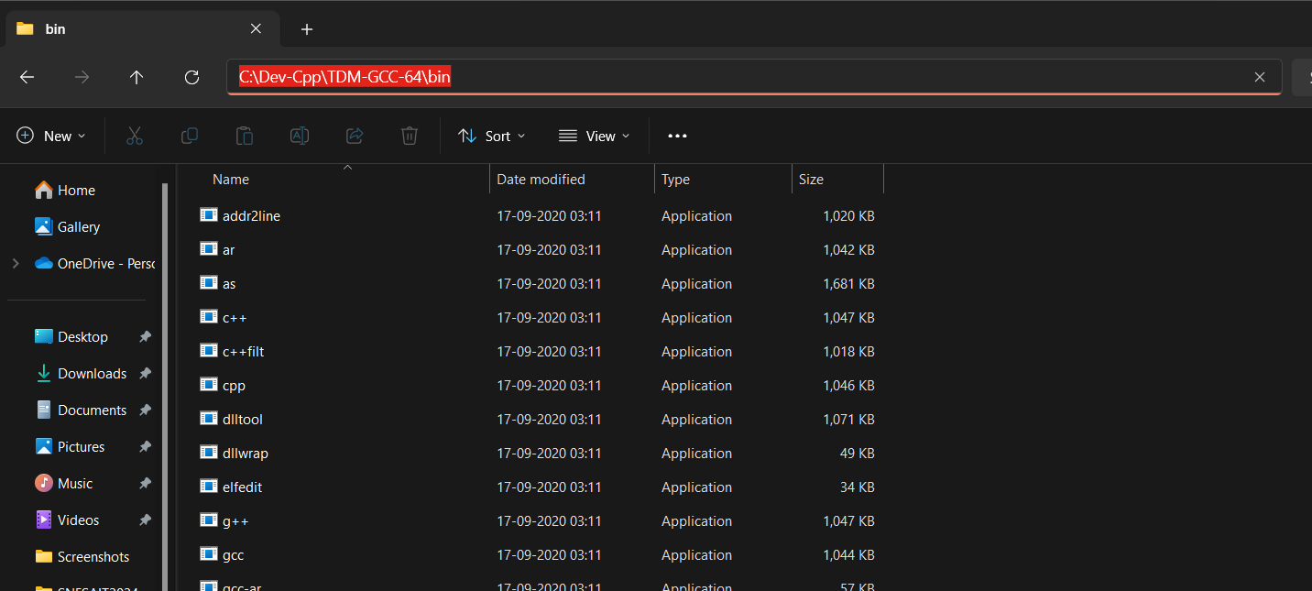
Click on New ,then browse in Local Disk C: where you have installed Dev-Cpp, then goto TDM-GCC-64\bin ,copy the path and paste.

Slide 12
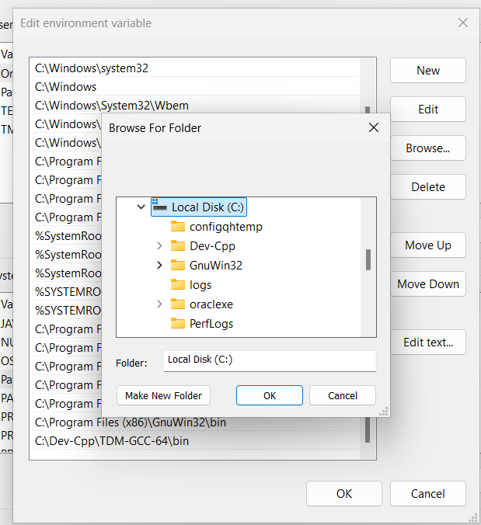
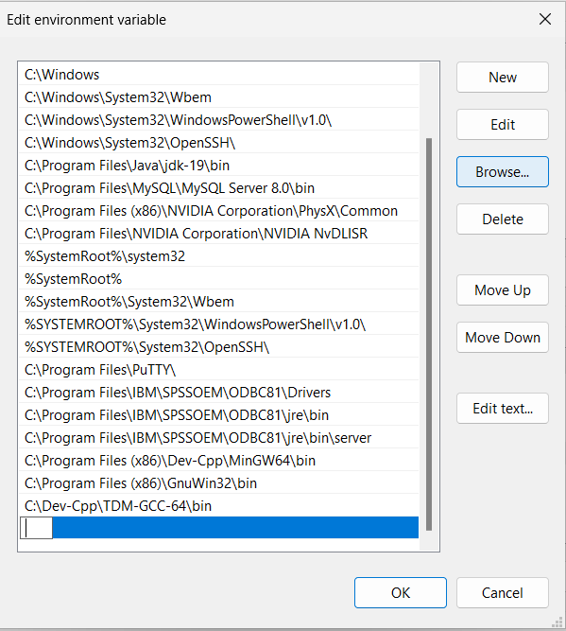

Slide 13
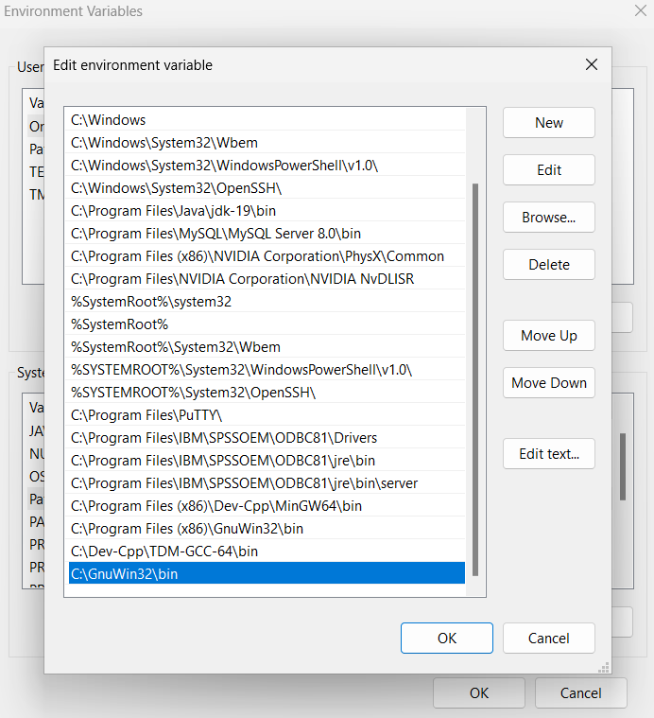
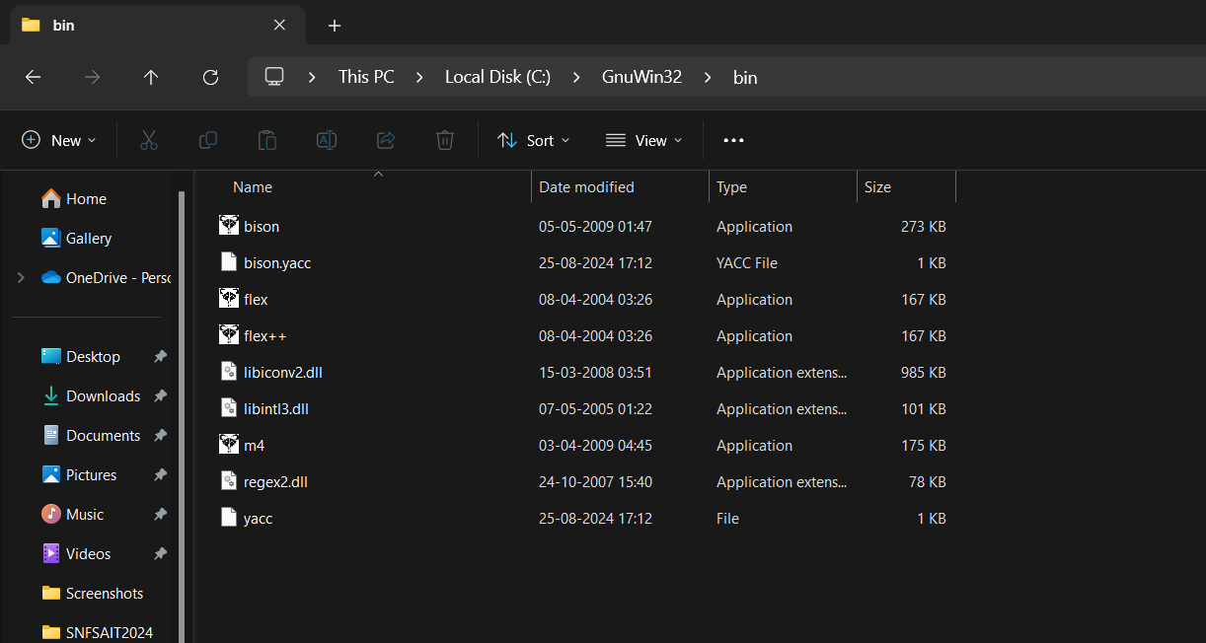
GnuWin32 includes both bison and flex in bin folder, add path C:\GnuWin32\bin

Slide 14
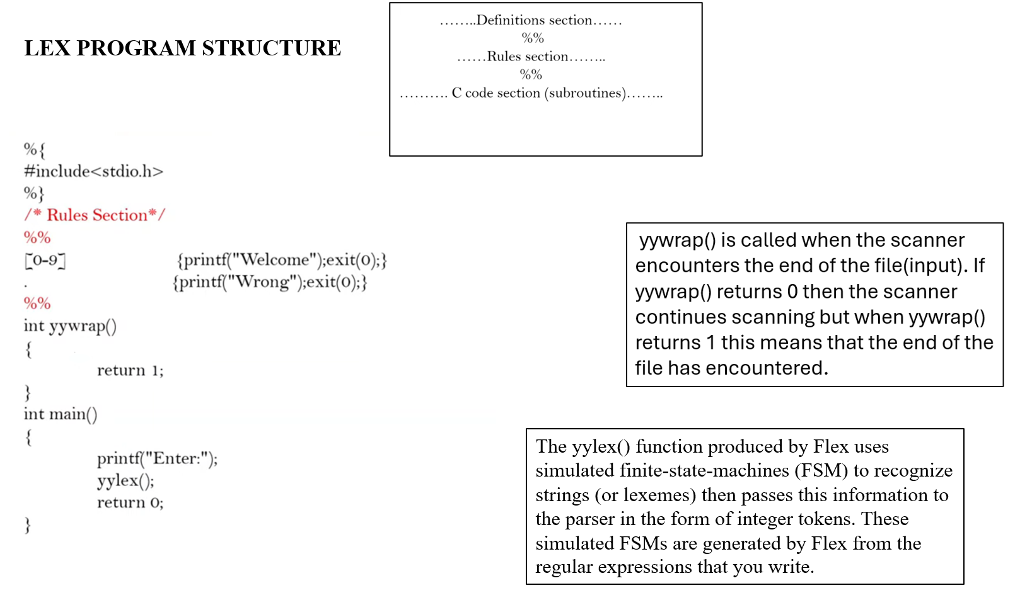

Slide 15
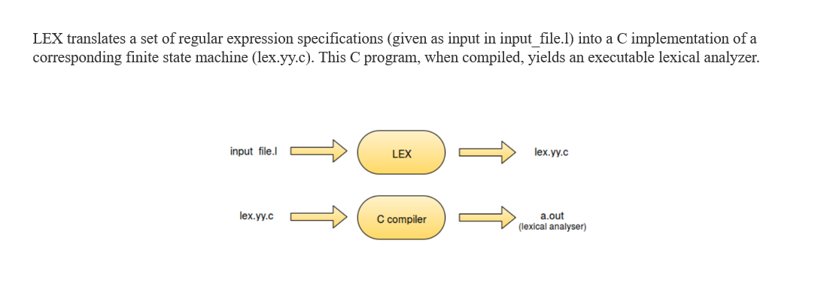
Compilation & Execution

Slide 16
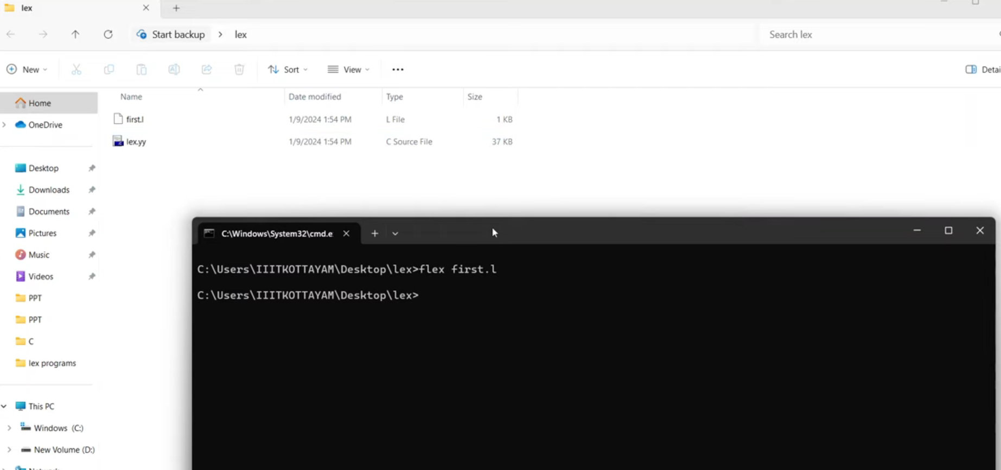

Slide 17
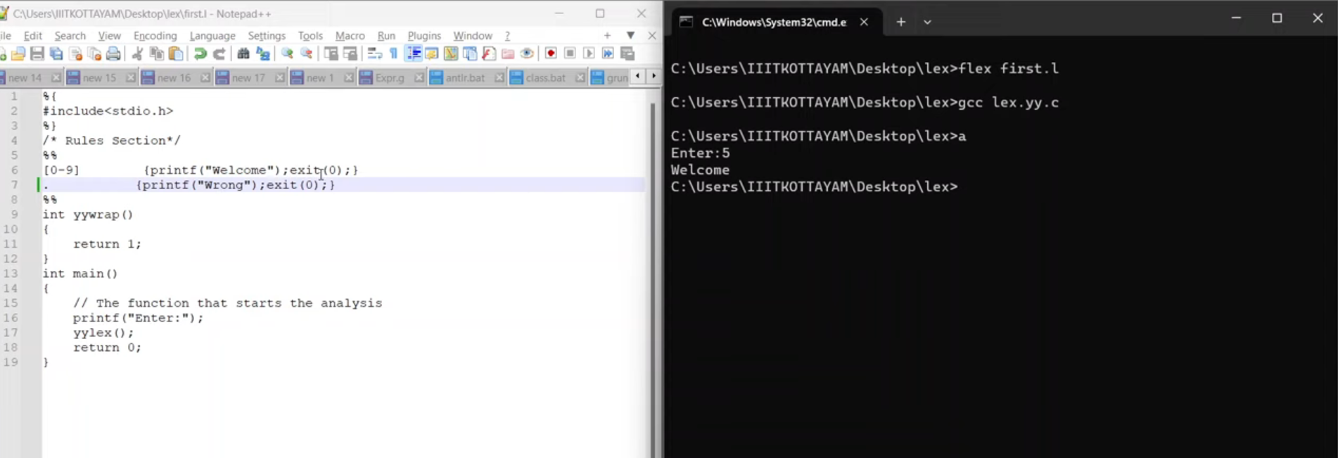

Slide 18
